Slide 1

Alzheimer's Disease Data Analysis
A Comprehensive Study on Medical and Lifestyle Factors

Slide 2

Importance of Alzheimer's Disease Data Analysis
Impact on Research
Early Detection & Prevention:
Value for Healthcare Practitioners
Data-Driven Decisions:
Identifying key demographic, lifestyle, and clinical factors helps in recognizing early warning signs, potentially leading to earlier diagnosis and interventions.
Improving Treatment Strategies:
Understanding how medical history and cognitive symptoms affect Alzheimer's progression can inform personalized treatment plans.
Healthcare providers can use insights from such data analysis to make more informed decisions about patient care, focusing on high-risk individuals.
Public Health Planning:
This analysis can guide resource allocation, such as targeting education and prevention programs to high-risk groups identified through the data.

Slide 3
Importance of Alzheimer's Disease Data Analysis
Benefits for Data Scientists
Advanced Data Modeling:
The richness of this dataset provides opportunities to apply machine learning models for predicting Alzheimer’s diagnosis based on complex interactions between variables.
Feature Engineering & Exploration:
Data scientists can experiment with different feature combinations to improve model performance, contributing to innovations in predictive healthcare analytics.
Broader Societal Impact
Reducing Healthcare Costs:
Early diagnosis and prevention based on such analyses could potentially reduce the financial burden of Alzheimer’s disease on healthcare systems.
Enhanced Patient Outcomes:
Providing more accurate diagnoses and tailored treatment improves patient quality of life.

Slide 4
Dataset Overview
Patient ID
PatientID: A unique identifier assigned to each patient (4751 to 6900).
Demographic Details
Age: The age of the patients ranges from 60 to 90 years.
Gender: Gender of the patients, where 0 represents Male and 1 represents Female.
Ethnicity: The ethnicity of the patients, coded as follows:
0: Caucasian
1: African American
2: Asian
3: Other
EducationLevel: The education level of the patients, coded as follows:
0: None
1: High School
2: Bachelor's
3: Higher

Slide 5
Dataset Overview
Lifestyle Factors
BMI: Body Mass Index of the patients, ranging from 15 to 40.
Medical History
FamilyHistoryAlzheimers: Family history of Alzheimer's Disease, where 0 indicates No and 1 indicates Yes.
Smoking: Smoking status, where 0 indicates No and 1 indicates Yes.
AlcoholConsumption: Weekly alcohol consumption in units, ranging from 0 to 20.
PhysicalActivity: Weekly physical activity in hours, ranging from 0 to 10.
DietQuality: Diet quality score, ranging from 0 to 10.
SleepQuality: Sleep quality score, ranging from 4 to 10.
CardiovascularDisease: Presence of cardiovascular disease, where 0 indicates No and 1 indicates Yes.
Diabetes: Presence of diabetes, where 0 indicates No and 1 indicates Yes.
Depression: Presence of depression, where 0 indicates No and 1 indicates Yes.
HeadInjury: History of head injury, where 0 indicates No and 1 indicates Yes.
Hypertension: Presence of hypertension, where 0 indicates No and 1 indicates Yes.

Slide 6
Dataset Overview
Clinical Measurements
SystolicBP: Systolic blood pressure, ranging from 90 to 180 mmHg.
DiastolicBP: Diastolic blood pressure, ranging from 60 to 120 mmHg.
CholesterolTotal: Total cholesterol levels, ranging from 150 to 300 mg/dL.
CholesterolLDL: Low-density lipoprotein cholesterol levels, ranging from 50 to 200 mg/dL.
CholesterolHDL: High-density lipoprotein cholesterol levels, ranging from 20 to 100 mg/dL.
CholesterolTriglycerides: Triglycerides levels, ranging from 50 to 400 mg/dL.
Cognitive and Functional Assessments
MMSE: Mini-Mental State Examination score, ranging from 0 to 30. Lower scores indicate cognitive impairment.
FunctionalAssessment: Functional assessment score, ranging from 0 to 10. Lower scores indicate greater impairment.
MemoryComplaints: Presence of memory complaints, where 0 indicates No and 1 indicates Yes.
BehavioralProblems: Presence of behavioral problems, where 0 indicates No and 1 indicates Yes.
ADL: Activities of Daily Living score, ranging from 0 to 10. Lower scores indicate greater impairment.

Slide 7
Dataset Overview
Symptoms
Confusion: Presence of confusion, where 0 indicates No and 1 indicates Yes.
Disorientation: Presence of disorientation, where 0 indicates No and 1 indicates Yes.
PersonalityChanges: Presence of personality changes, where 0 indicates No and 1 indicates Yes.
DifficultyCompletingTasks: Presence of difficulty completing tasks, where 0 indicates No and 1 indicates Yes.
Forgetfulness: Presence of forgetfulness, where 0 indicates No and 1 indicates Yes.
Diagnosis Information
Diagnosis: Diagnosis status for Alzheimer's Disease, where 0 indicates No and 1 indicates Yes.

Slide 8
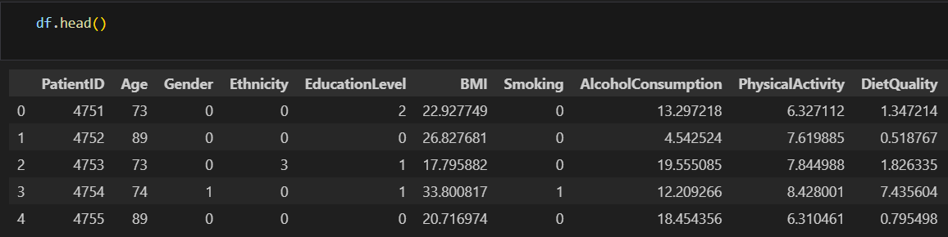
Dataset Overview

Slide 9
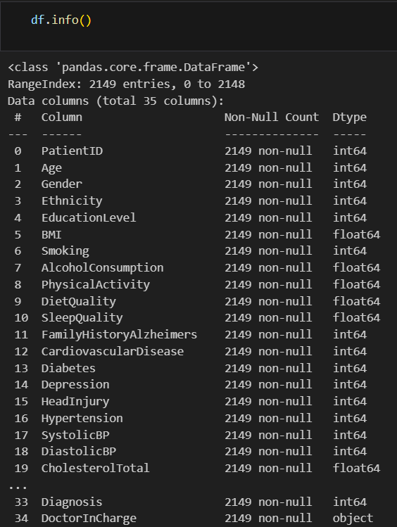
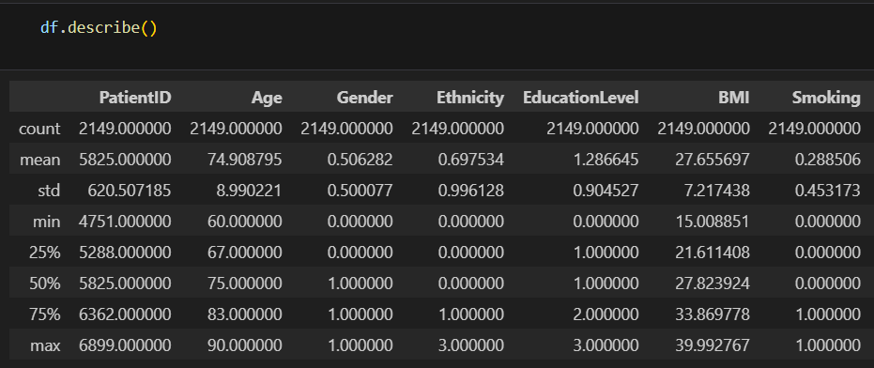
Data Cleaning and Preprocessing
Initial Exploration:
Reviewed data with .head(), .info(), and .describe() to understand the structure and key statistics.

Slide 10
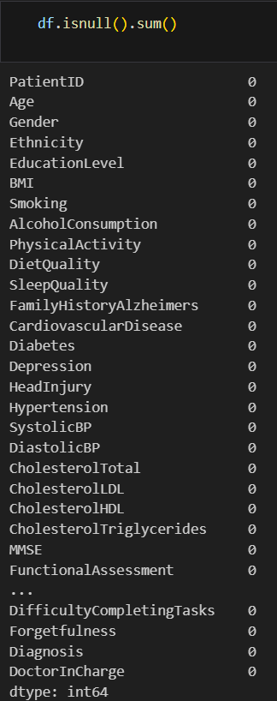

Data Cleaning and Preprocessing
Initial Exploration:
Check missing values.
Dropped unnecessary columns (e.g., DoctorInCharge).

Slide 11
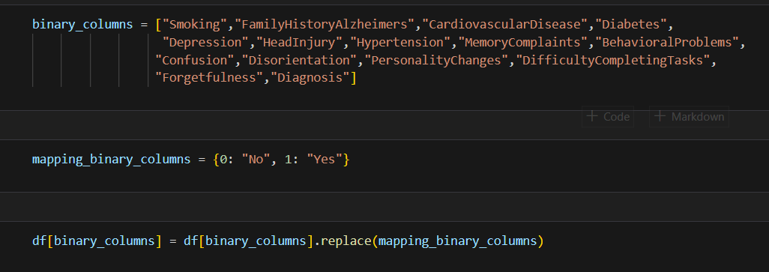
Data Cleaning and Preprocessing
Categorical Variable Encoding:
Converted binary columns like "Smoking," "Diabetes," etc., from numeric to "Yes/No" categories.

Slide 12

Data Cleaning and Preprocessing
Categorical Variable Encoding:
Encoded gender, ethnicity, and education level.

Slide 13
Power Query Transformations
BMI Grouping
if [BMI] < 18.5 then "Underweight" else if [BMI] < 25 then "Normal“ else if [BMI] < 30 then "Overweight" else "Obese"
ADL Grouping
if [ADL] <= 3 then "Low" else if [ADL] <= 7 then "Medium" else "High"
Functional Assessment Grouping
if [FunctionalAssessment] <= 3 then "Low" else if [FunctionalAssessment] <= 7 then "Medium" else "High"

Slide 14
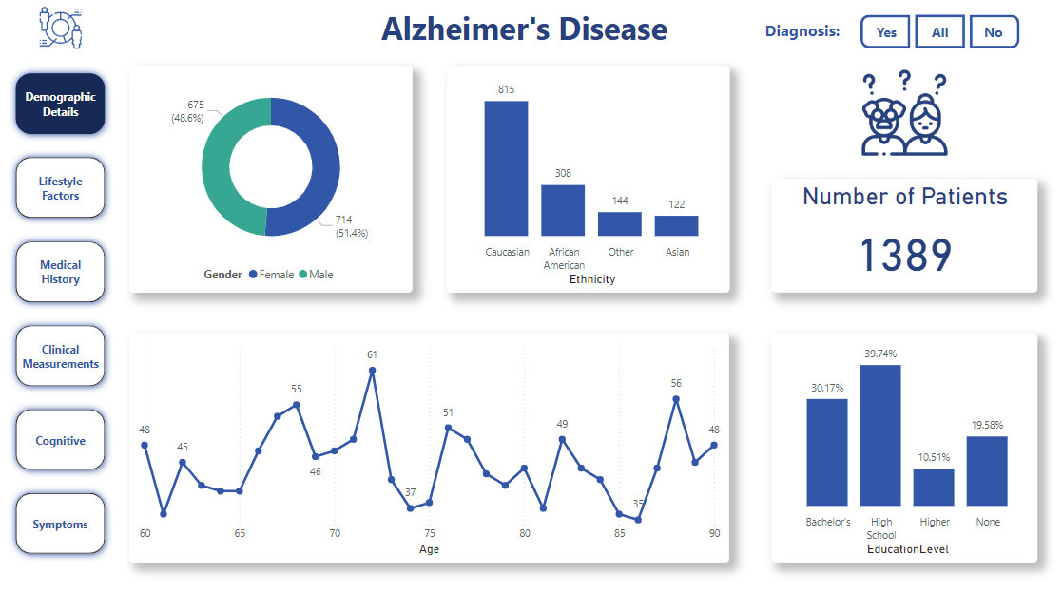

Slide 15
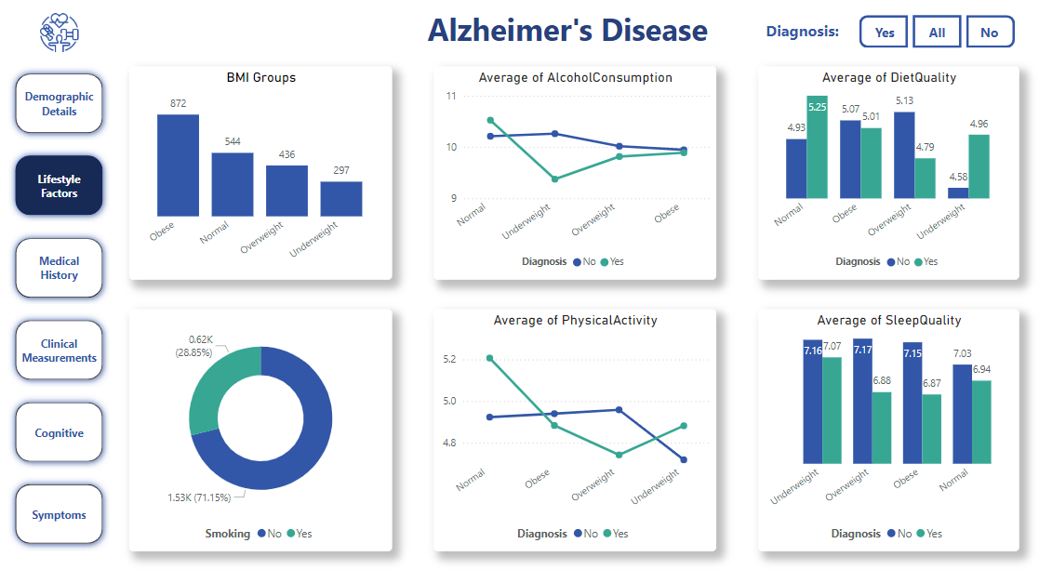

Slide 16
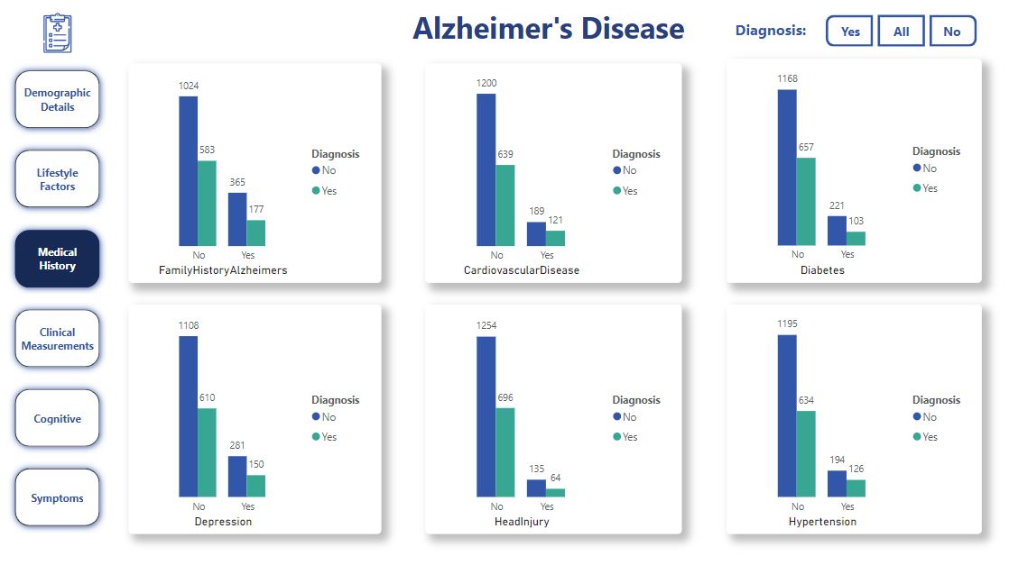

Slide 17
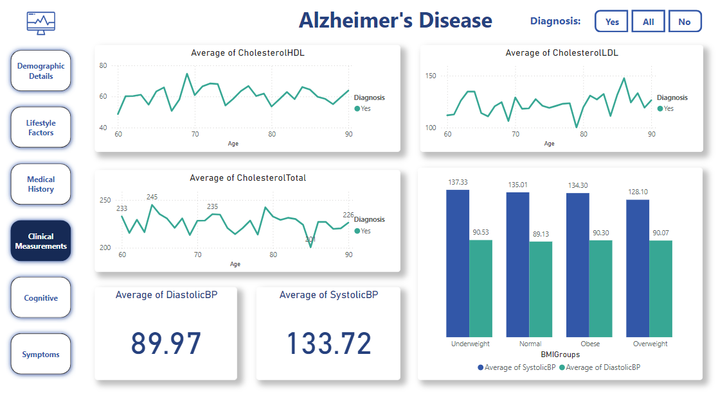

Slide 18
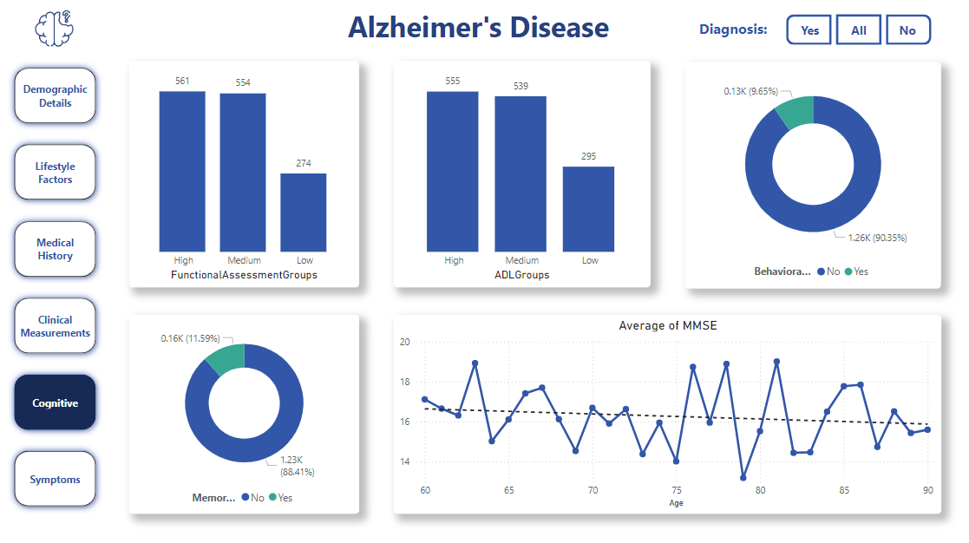

Slide 19
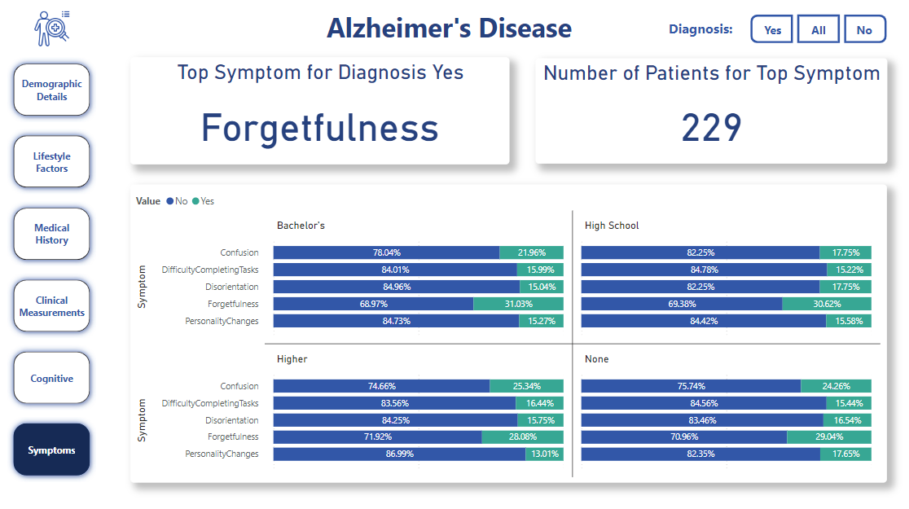

Slide 20
Presented by
Ali Mohamed Taha
Ahmed Mohamed Abdelfadil
Kerolos Remon Mubarak
Ziad Hesham Shetewa

Slide 21
Thanks

